Slide 1



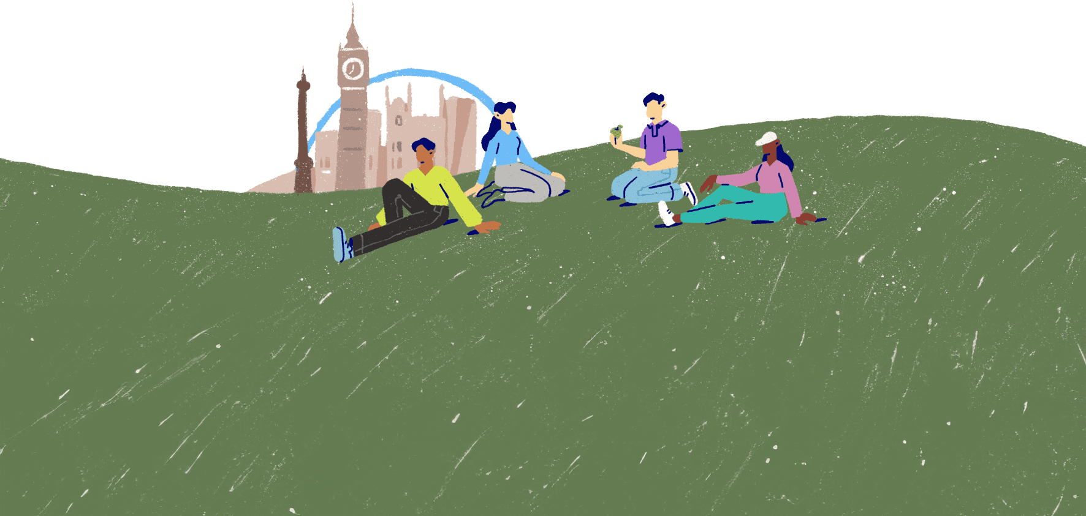
Attitudes towards mental health
Lesson 2

Slide 2
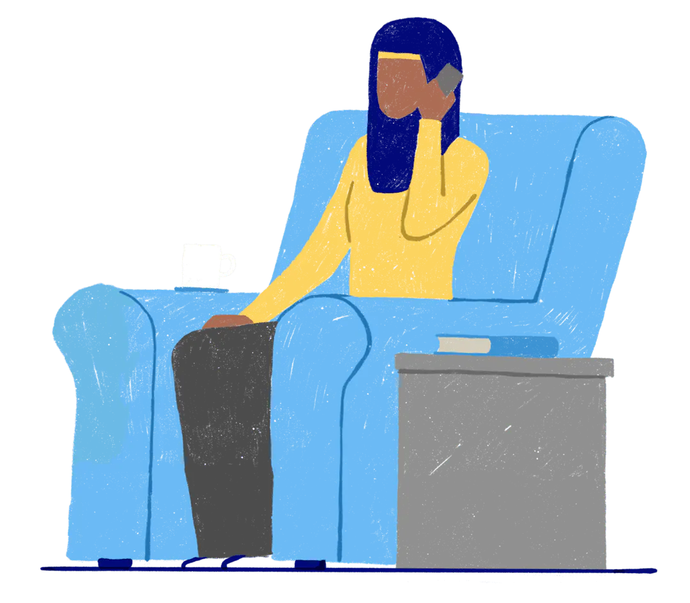
How are you?
Why do you think some people might feel uncomfortable talking about their emotions, mental health or mental wellbeing?​
​
When someone asks you how you are, do you stop to think about how you're feeling?
Do you share information about your mental health and wellbeing?
Some people feel comfortable talking about their feelings, while others don't feel comfortable at all.

Slide 3
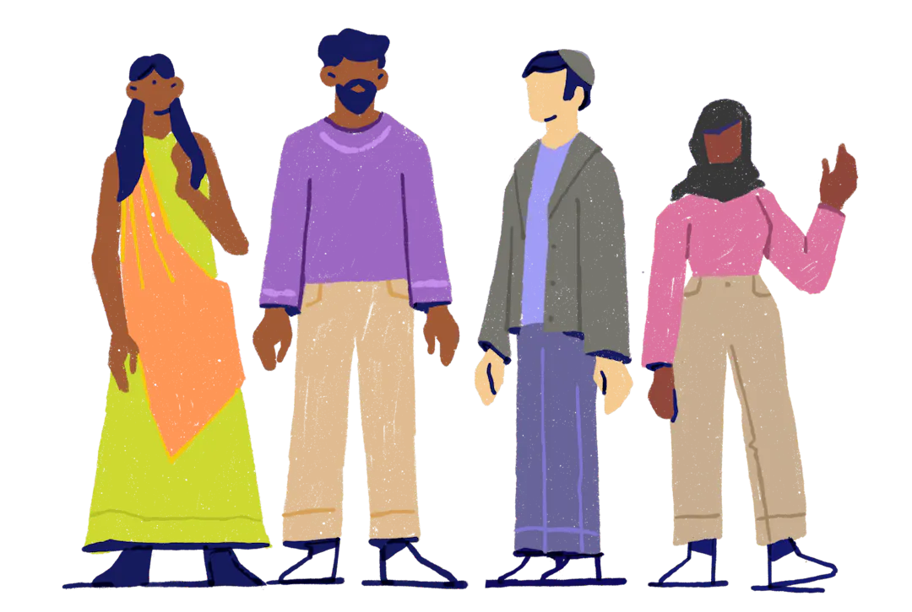
How we feel about mental health and wellbeing
The topic of mental health and wellbeing has been thought about in different ways during different times in history.
The topic may also receive different responses among different cultures or groups of people in society.
Can you think of any examples that might link to the way people feel about mental health and wellbeing?

Slide 4
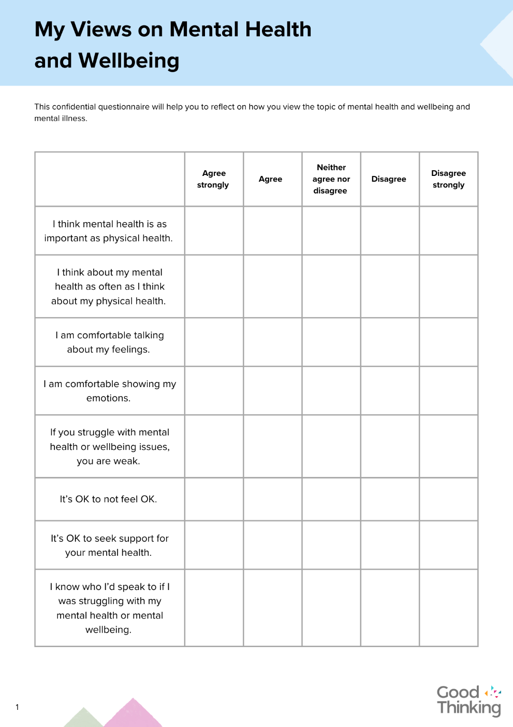
Your personal views
We're going to complete a questionnaire about our own personal views on mental health and wellbeing.
Your responses won't be shared with anyone, but it will help you reflect on your own attitudes towards this topic.

Slide 5



A growing awareness
Let's discuss:
Do you feel that mental health and wellbeing is considered by society to be as important as physical health and wellbeing?
Do you think people today are more aware of mental health challenges?
Do you think people today are more tolerant and supportive of people with mental health difficulties?

Slide 6
Stereotypes, stigma and discrimination
A stereotype is a view held by many that isn't accurate.
Some people might believe that people with mental health difficulties are dangerous. Actually, people with mental health challenges are at a higher risk of being attacked or harming themselves than hurting other people.
Stigma is a mark of shame or disgrace.
Some people may feel ashamed of having a mental health condition. The stigma around mental health issues can prevent people from talking about their difficulties and seeking help.
Discrimination means treating people differently – in a way that is unfair or unequal.
People with mental health challenges may be seen as having less value and may be denied the same opportunities as those without mental health challenges.
What is a stereotype?
What is a stigma?
What is a discrimination?
(click to reveal)
(click to reveal)
(click to reveal)

Slide 7


Mental health and gender
The UK Parliament 2014 survey of Mental Health and Wellbeing in England found that women were more likely than men to be experiencing common mental health challenges.
Do you think these statistics would be the same or in a survey conducted now?
Do you think women experience more mental health challenges than men?
Might it be that just as many men experience mental health difficulties, but they keep it to themselves?
Might there be a reason why women do experience more common mental health difficulties?

Slide 8
Change for the better
What can change to ensure that people with mental health challenges are better understood and supported, and treated as equal members of society?
charities
support
awareness
laws
companies
education
information
media
health care
research
government policies
friends
communities
sharing experiences

Slide 9

"Mental health is something that we all need to talk about, and we need to take the stigma away from it. So, let's raise awareness. Let's let everybody know it's OK to have a mental illness."
Demi Lovato
Photo by Joel Vodell on Unsplash

Slide 10


